Slide 1
Digital Portfolio
STUDENT NAME: V.Kaviya
REGISTER NO AND NMID: 212404616/AE93D47C0DF5445851B41C03788F25D9
DEPARTMENT: BCA
COLLEGE: R.B.Gothi Jain College For Women/Madras University

Slide 2
PROJECT TITLE
“Personal Digital Portfolio Website Showcasing Skills, Projects, and Career Ambitions”

Slide 3


AGENDA
Problem Statement
Project Overview
End Users
Tools and Technologies
Portfolio design and Layout
Features and Functionality
Results and Screenshots
Conclusion
Github Link
3/21/2024 Annual Review

Slide 4

PROBLEM STATEMENT
In today’s digital era, students and professionals need an online presence to showcase their skills, education, and career goals. Traditional paper resumes are limited in reach and interactivity, while digital platforms provide greater visibility and engagement

Slide 5

PROJECT OVERVIEW
This project focuses on developing a digital portfolio website using HTML, CSS, and JavaScript. The portfolio serves as a personal platform to present the creator’s background, education, skills, projects, and career ambitions in an organized and professional manner. It is designed with a responsive layout to ensure accessibility across different devices and includes interactive elements for better user experience

Slide 6

WHO ARE THE END USERS?
The end users of the digital portfolio include recruiters and employers, who can explore the creator’s skills, projects, and qualifications to evaluate suitability for job opportunities. It also benefits college faculty members, as they can assess academic growth and project work. The portfolio further helps in building professional connections, allowing peers and industry professionals to view and appreciate the creator’s abilities. Lastly, the creator themselves is an end user, as the portfolio acts as a personal branding platform to showcase achievements, skills, and career ambitions in the IT field.

Slide 7
TOOLS AND TECHNIQUES
The digital portfolio was developed using HTML, CSS, and JavaScript. HTML was used to create the structure of the website, dividing it into sections such as About Me, Projects, Skills, and Contact. CSS was applied for styling and responsive web design, ensuring the portfolio looks professional and adapts to different screen sizes. JavaScript was used to add interactivity, including smooth scrolling and form handling in the contact section

Slide 8
POTFOLIO DESIGN AND LAYOUT
Home/about me:Know more button to scroll to other sections
Project: Recruiters or evaluators understand practical skills (html,css,java script)
Skills: Grid and card layout
Contact: Allow visitors to send message Responsive layout: Responsive web design
‹#›

Slide 9
FEATURES AND FUNCTIONALITY
The digital portfolio includes key features such as an About Me section to introduce the creator, a Projects section to showcase practical work, a Skills section to highlight technical abilities, and a Contact section for communication. Its functionality is enhanced with smooth scrolling, an interactive contact form, and a section-wise layout for easy navigation. Additionally, the portfolio is fully responsive, ensuring it works seamlessly across desktops, tablets, and mobile devices.

Slide 10
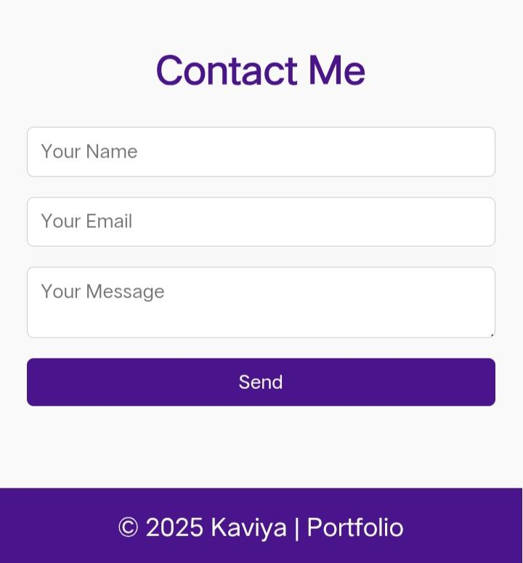
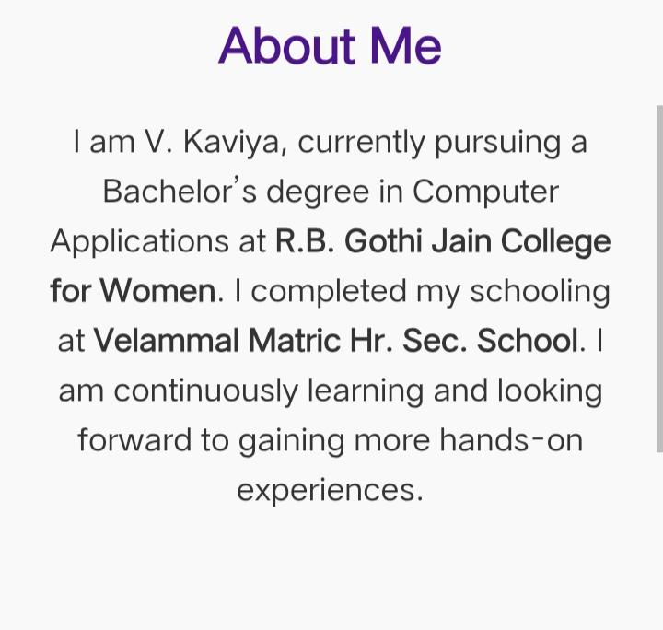
RESULTS AND SCREENSHOTS
3/21/2024 Annual Review
‹#›

Slide 11
CONCLUSION
The Digital Portfolio Website was successfully developed using HTML, CSS, and JavaScript. The project demonstrates how a personal portfolio can serve as an effective platform to showcase individual identity, educational background, technical skills, and projects in a structured and visually appealing way.
‹#›

